Slide 1
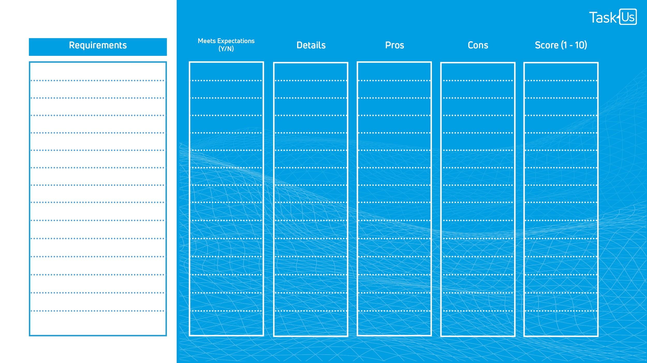
Vendor Name:
Aligned Cultural Fit
Y/N
Time Zones & Location Offering
Y/N
Attrition Rate Percentage
Y/N
Employee Referral Rate Percentage
Y/N
Industry Certifications
Y/N
Onboarding Process
Y/N
Use of Cloud-based Systems
Y/N
Cost
Y/N
Enter Your Custom Requirements
Y/N
Y/N
Y/N
Y/N
Y/N
Y/N
Y/N

Slide 2
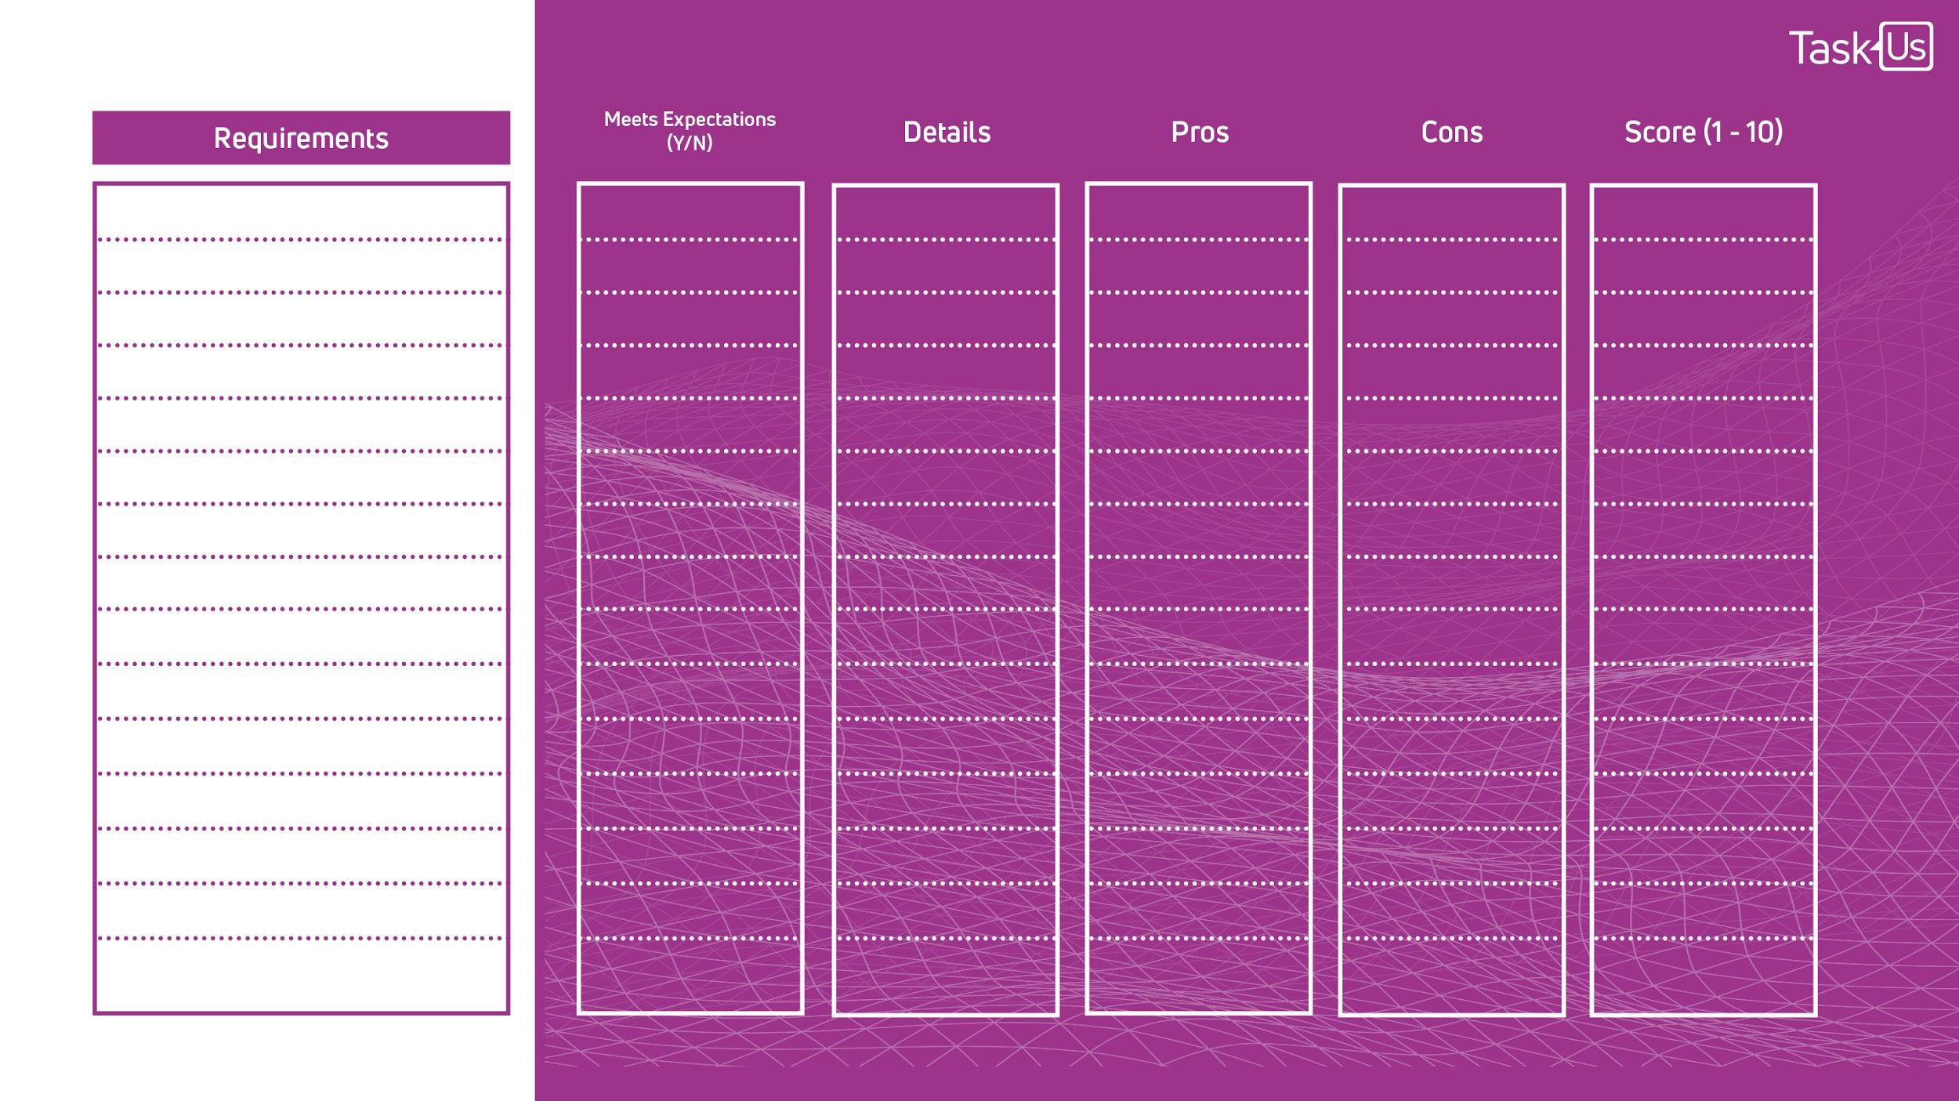
Vendor Name:
Aligned Cultural Fit
Y/N
Time Zones & Location Offering
Y/N
Attrition Rate Percentage
Y/N
Employee Referral Rate Percentage
Y/N
Industry Certifications
Y/N
Onboarding Process
Y/N
Use of Cloud-based Systems
Y/N
Cost
Y/N
Enter Your Custom Requirements
Y/N
Y/N
Y/N
Y/N
Y/N
Y/N
Y/N

Slide 3
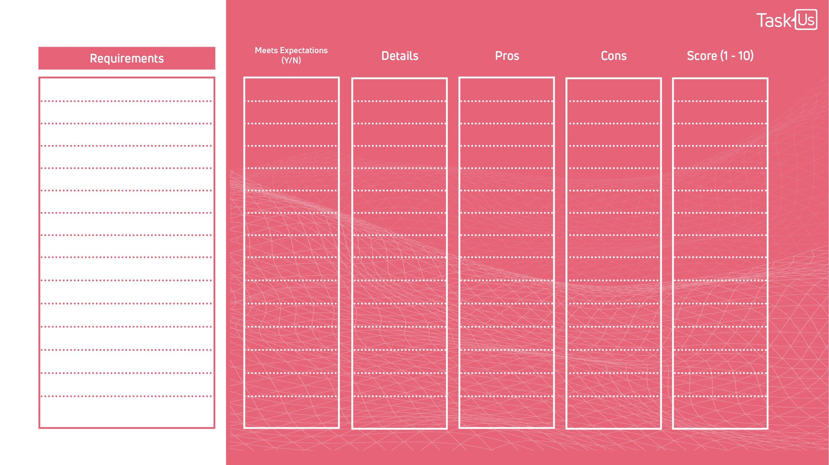
Vendor Name:
Aligned Cultural Fit
Y/N
Time Zones & Location Offering
Y/N
Attrition Rate Percentage
Y/N
Employee Referral Rate Percentage
Y/N
Industry Certifications
Y/N
Onboarding Process
Y/N
Use of Cloud-based Systems
Y/N
Y/N
Cost
Enter Your Custom Requirements
Y/N
Y/N
Y/N
Y/N
Y/N
Y/N
Y/N

